Slide 14
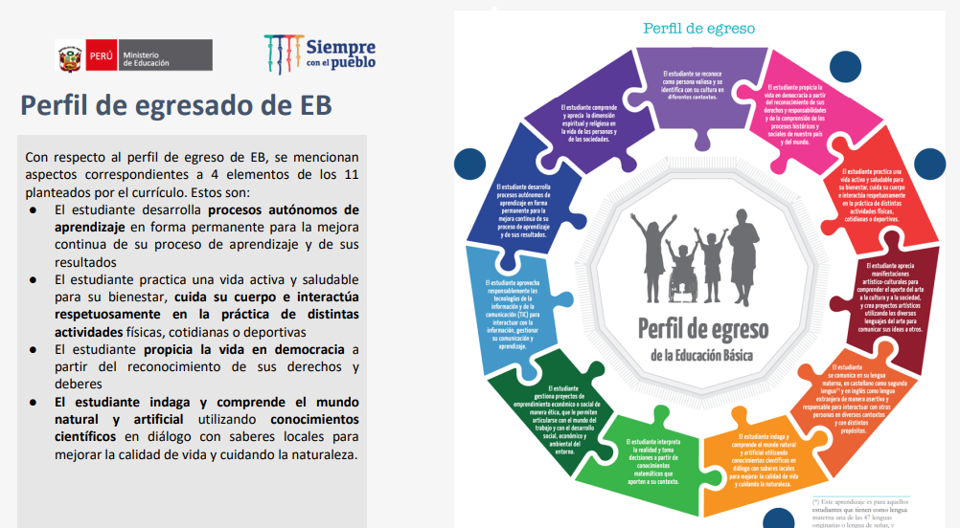

Slide 19
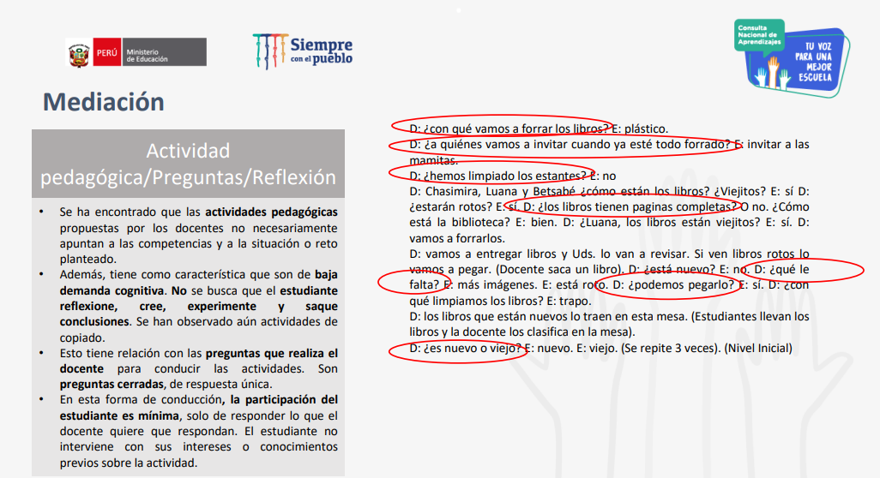

Slide 21
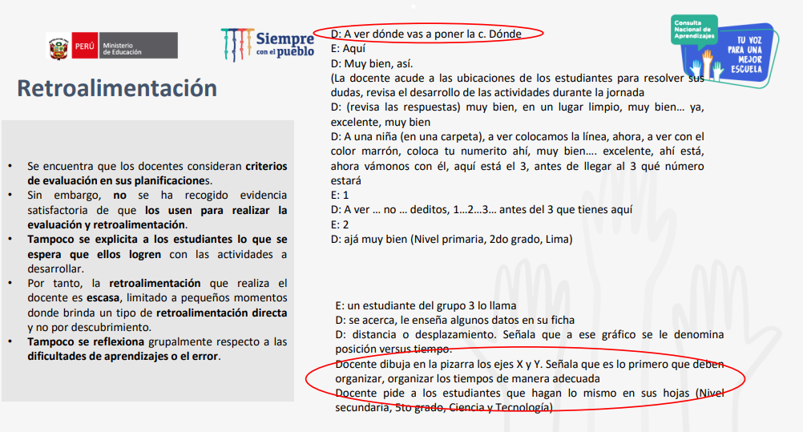

Slide 24
PRACTIQUEMOS
https://forms.gle/LNbmVsyw1Se93A236

